Slide 1
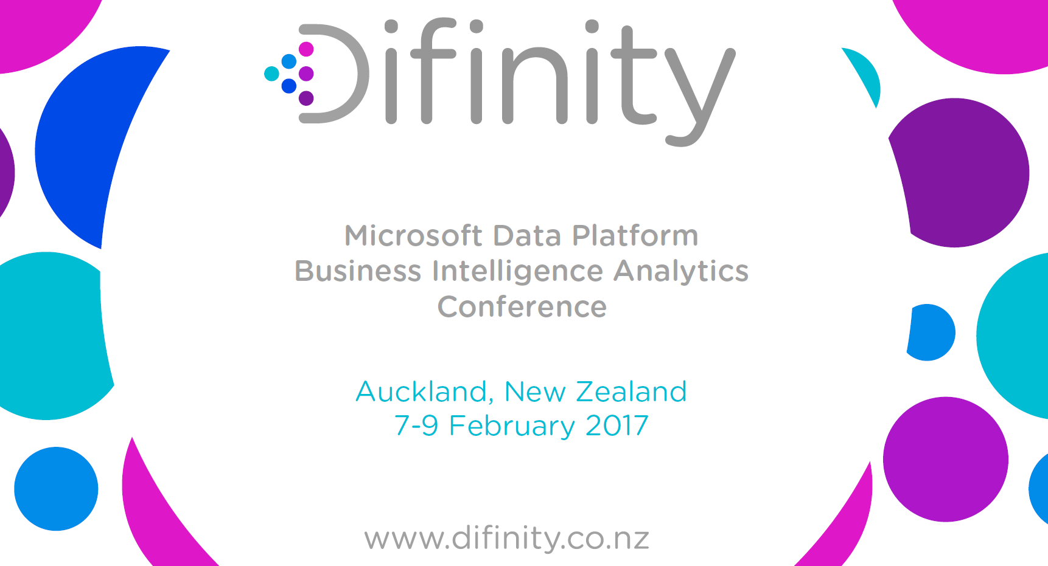
Welcome
Auckland, New Zealand
18-20 February 2019

Slide 2



Data wrangling with Azure Databricks
Regan Murphy
Software Engineer, Microsoft
@nzregs regan.murphy@microsoft.com

Slide 3
Data wrangling with Azure Databricks
Track: AI, Azure Length: 75 minutes Level: 300 (Advanced)
In this session we’ll take a look at Azure Databricks and how you can use it to load, transform, and persist your data.
From connecting to storage and data sources (both sink and source), to manipulating and transforming dataframes using Scala, Python, and Spark SQL, and stream processing with Spark Structured Streaming.
We will also explore how to automate your data wrangling jobs using the Azure Databricks scheduled jobs, using Azure Data Factory, and by exporting code and running in a dedicated spark cluster in containers.

Slide 4
Agenda
Intro to Azure Databricks
Scenario
Technical Demos
Secrets
Hot Path to Power BI
Structured Streaming – Azure Event Hubs Ingestion
Warm Path to Cosmos DB
Structured Streaming – Azure Event Hubs Ingestion
Cold Path, via storage, to SQL Data Warehouse
Azure Event Hub Capture, Blob Storage, ADLS Gen 2, Azure Data Factory

Slide 5
Intro to Azure Databricks

Slide 6



What is Azure Databricks ?
A fast, easy and collaborative Apache® Spark™ based analytics platform optimized for Azure
Best of Databricks
Best of Microsoft
Designed in collaboration with the founders of Apache Spark
One-click set up; streamlined workflows
Interactive workspace that enables collaboration between data scientists, data engineers, and business analysts.
Native integration with Azure services (Power BI, SQL DW, Cosmos DB, Blob Storage, ADF, SQL DB, AAD)
Enterprise-grade Azure security (Active Directory integration, compliance, enterprise-grade SLAs – 99.95%)

Slide 7
Spark Architecture & Dataframes
Driver Program SparkContext
‘Driver’ runs the user’s ‘main’ function and executes the various parallel operations on the worker nodes.
To take advantage of Spark – you use Dataframes as the data structure.
Once your Data is in the DataFrame – Spark can parallelize operations.
The Dataframes support both batch and streaming data.
The results of the operations are collected by the driver
Cluster Manager
Worker Node
Worker Node
Worker Node
Cache
Cache
Cache
Task
Task
Task
Data Sources (Azure Storage, Cosmos DB, SQL)
Notes:
Remove this slide

Slide 8
Databricks Notebooks 101
Some basics

Slide 9
The Scenario

Slide 10
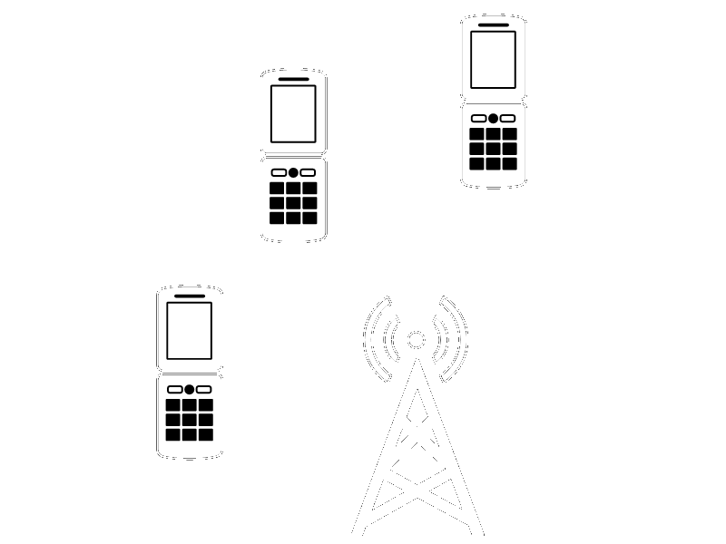


Mobile Telco Billing
Web
Mobile
Apps
Notes:
This is what a typical mobile telco billing model would look like.
User makes call, the cell tower records a “CDR” (call detail record)
The CDR logs would batched and sent from the tower to a central file store
An ETL process would run over the files to insert the data, with some aggregation, into a back end database – typically an SQL based DB
There are some obvious challenges with this architecture – particularly at scale. How many of you have logged in to your mobile providers app or website and seen the following? <next slide>

Slide 11
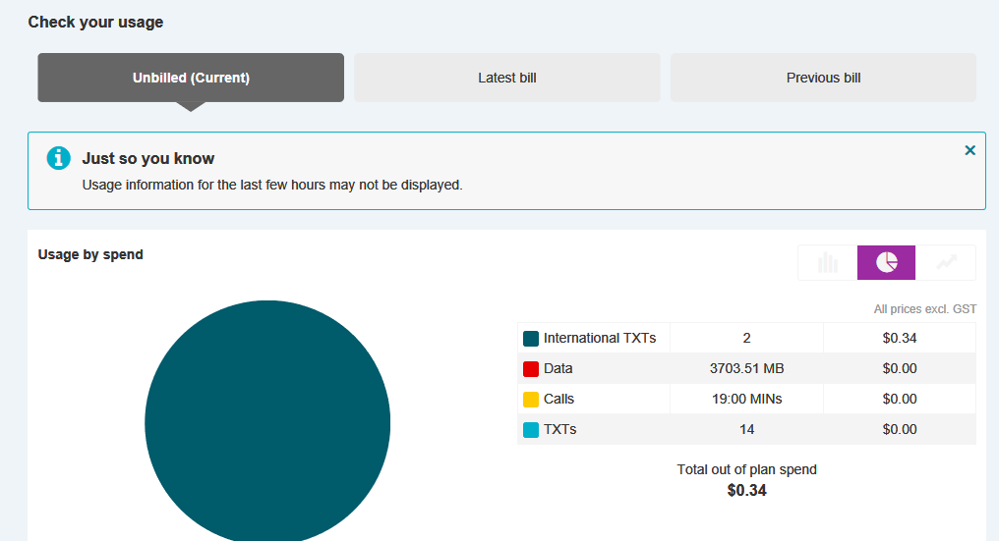
Notes:
“just so you know… usage information for the last few hours may not ne displayed”
This is because there is a latency between when you make your call, and when the data about that call is available for the billing system to present to you as the user.
In the beginning, when a mobile provider only handled calls and SMS, and with fewer customers, this model probably worked ok. These days a mobile provider has a complex business offering calls, sms, and web – with many products and billing plans – such as free SMS to certain destinations, or zero-rated traffic to particular websites.
There are also a lot more mobile subscribers, and the size of the logging has increased exponentially with the addition of web/data traffic given the number of requests per session of browsing, for example.
What does this all mean? It means that the delay between when a customer makes a call, SMS, or browses a website, and when that usage data is available in the billing app to show the customer what they effectively have left on their plan, gets larger and larger.
This is where a modern big data architecture can help.

Slide 12


Telco Data Pipeline, Difinity 2018
Transactional
Database
Data Factory
SQL Server
Power BI
Azure Data Lake Store
HDInsight
(Hadoop and Spark)
SQL Data Warehouse
Blob Storage
Web
JSON
Stream Analytics
Mobile
Power BI
Apps
Bots
Event Hubs
Ad-hoc queries over raw data, ETLs
Historical Reporting
Near Real Time Insight
Notes:
Last year at Difinity we took a look at how we would build this architecture incorporating Stream Analytics and HD Insight (Hadoop).

Slide 13


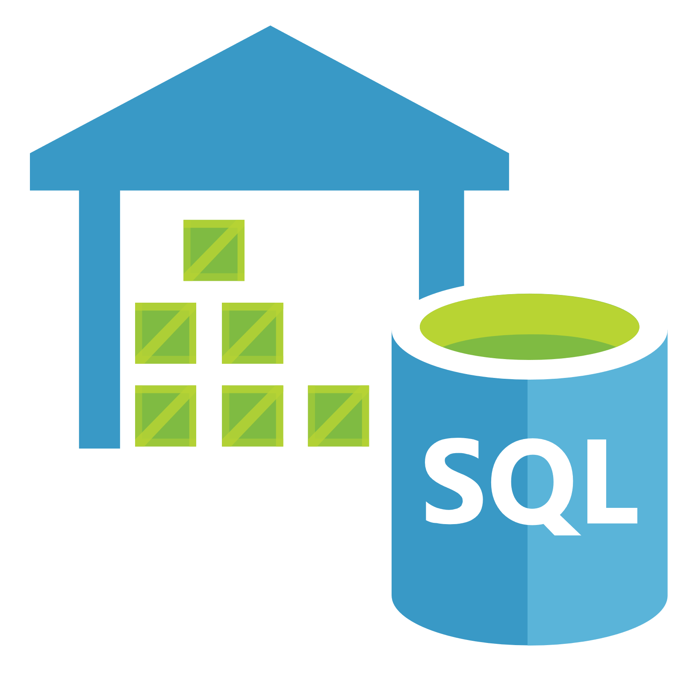






Telco Data Pipeline, Difinity 2019
Historical Reporting
Transactional
Database
Data Factory (ETL, Data movement)
Near real time anomaly detection
Azure Databricks (Spark)
SQL Data Warehouse
Data Lake
JSON
Power BI
Event Hubs Capture
Blob Storage
SQL Server
Web
Event Hubs
Azure Databricks
(Structured Streaming)
Cosmos DB
Apps
Mobile
Bots
Power BI
User Profiles and Mobile App Data
ML Model Training
Ad-hoc queries over raw data
Near Real Time Insight
Notes:
This year at Difinity, we’ll see how it looks when we drop in Azure Databricks. You could still build this out using Stream Analytics and HD Insight – or create a hybrid with all of the products.
Near real-time anomaly detection – like fraud, tower capacity trends
Near real-time insight dashboards
Machine Learning model training, Ad-hoc queries over raw big data
Transactional/Billing system of record
Modern data warehouse for historical reporting
User profiles and mobile app data

Slide 14
Lambda – the hot path
Data Factory (ETL, Data movement)
SQL Data Warehouse
Data Lake
Databricks (Spark)
JSON
Power BI
Event Hubs Capture
Blob Storage
SQL Server
Web
Event Hubs
Databricks
(Structured Streaming)
Cosmos DB
Apps
Mobile
Bots
Power BI
Notes:
This is that Lambda architecture. It consists of
Hot Path
Warm Path
Cold Path
The hot path is where insights and anomaly detection are done in near-real-time. This is very time sensitive

Slide 15
Lambda – the warm path
Data Factory (ETL, Data movement)
SQL Data Warehouse
Data Lake
Databricks (Spark)
JSON
Power BI
Event Hubs Capture
Blob Storage
SQL Server
Web
Event Hubs
Databricks
(Structured Streaming)
Cosmos DB
Apps
Mobile
Bots
Power BI
Notes:
The warm path data is required ASAP, but does not have to be quite as fast as near-real-time

Slide 16
Lambda – the cold path
Data Factory (ETL, Data movement)
SQL Data Warehouse
Data Lake
Databricks (Spark)
JSON
Power BI
Event Hubs Capture
Blob Storage
SQL Server
Web
Event Hubs
Databricks
(Structured Streaming)
Cosmos DB
Apps
Mobile
Bots
Power BI
Notes:
The cold path data can take a lot longer and is typically batched. Hourly, Daily, Monthly – depending on the situation

Slide 17
Building the solution

Slide 18
Secrets
Don’t leak your credentials

Slide 19
Secret Management
When connecting to services from within Azure Databricks, you will frequently need to pass credentials. Best practice would be to keep these separate from your code.
Options (least secure ☹ to most secure ☺):
Plain text in notebooks << please avoid this!
Databricks Secret Scopes
Azure Key Vault backed Secret Scopes

Slide 20
Hot Path
Azure Event Hubs --> Power BI

Slide 21
Lambda – the hot path
Data Factory (ETL, Data movement)
SQL Data Warehouse
Data Lake
Databricks (Spark)
JSON
Power BI
Event Hubs Capture
Blob Storage
SQL Server
Web
Event Hubs
Databricks
(Structured Streaming)
Cosmos DB
Apps
Mobile
Bots
Power BI

Slide 22
Hot Path
Azure Event Hubs Connector for Apache Spark
Connect to the Azure Event Hub and ingest real-time events
https://github.com/Azure/azure-event-hubs-spark
Spark Scala & Spark SQL
Enrich streaming dataset using reference datasets
Aggregate using SQL Window functions, if necessary
Custom ForeachWriter
Write each row of the enriched, aggregated, dataset out to a Power BI custom streaming dataset using HTTP Post to the Power BI custom API endpoint

Slide 23
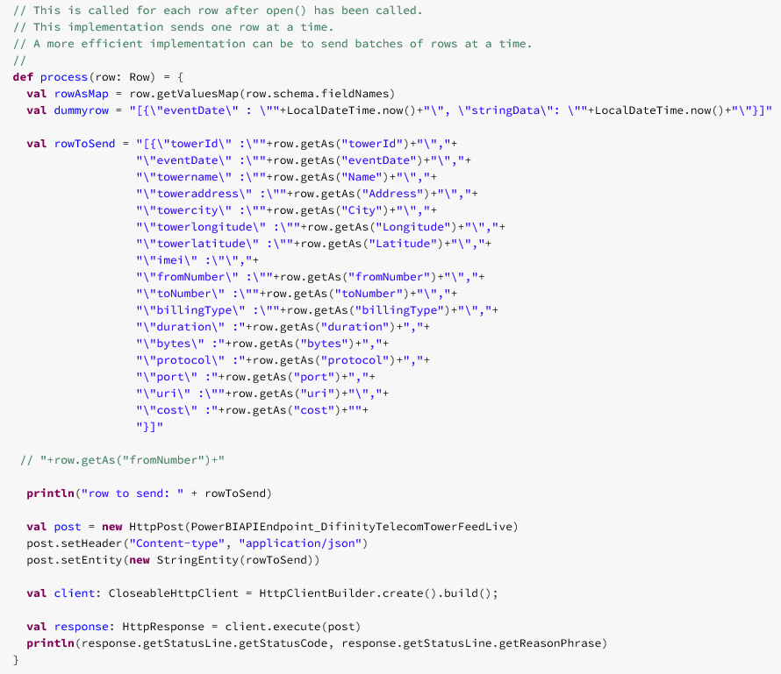
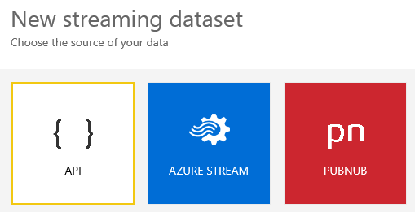
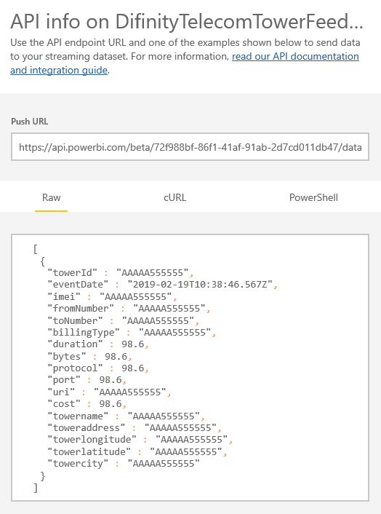
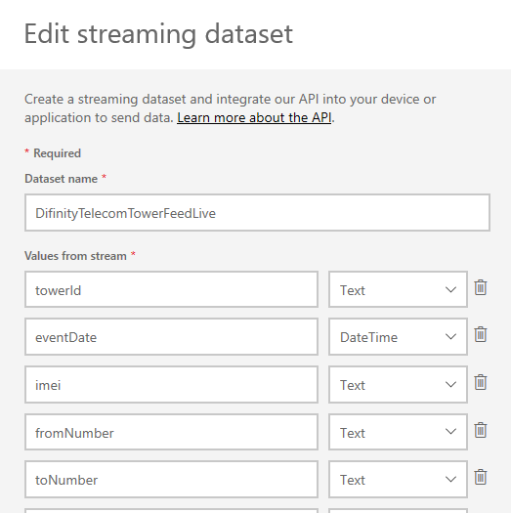
Power BI Custom Streaming Dataset API

Slide 24
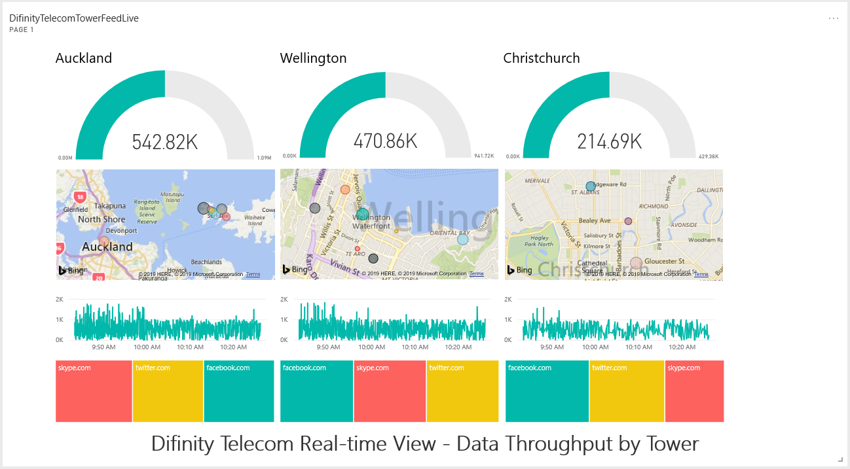

Slide 25
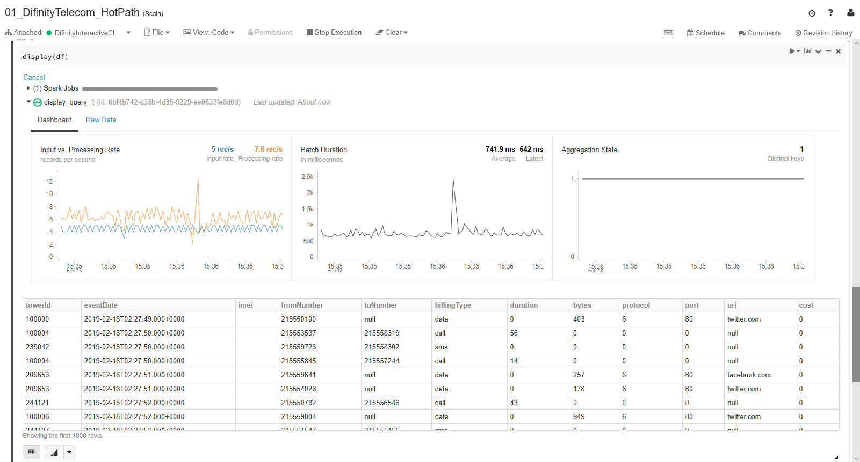

Slide 26
Warm Path
Azure Event Hubs --> Cosmos DB

Slide 27
Lambda – the warm path
Data Factory (ETL, Data movement)
SQL Data Warehouse
Data Lake
Databricks (Spark)
JSON
Power BI
Event Hubs Capture
Blob Storage
SQL Server
Web
Event Hubs
Databricks
(Structured Streaming)
Cosmos DB
Apps
Mobile
Bots
Power BI
Notes:
The warm path data is required ASAP, but does not have to be quite as fast as near-real-time

Slide 28
Warm Path
Azure Event Hubs Connector for Apache Spark
Connect to the Azure Event Hub and ingest real-time events
https://github.com/Azure/azure-event-hubs-spark
Spark Scala & Spark SQL
Enrich streaming dataset using reference datasets
Aggregate using SQL Window functions
Azure Cosmos DB Connector for Apache Spark
Write enriched, aggregated, streaming dataset out to Cosmos DB
https://github.com/Azure/azure-cosmosdb-spark

Slide 29
Cold Path
Azure Event Hub Capture
--> AVRO files on Azure Blob Storage -->Azure Datalake Gen2 -->SQL Data Warehouse

Slide 30
Lambda – the cold path
Data Factory (ETL, Data movement)
SQL Data Warehouse
Data Lake
Databricks (Spark)
JSON
Power BI
Event Hubs Capture
Blob Storage
SQL Server
Web
Event Hubs
Databricks
(Structured Streaming)
Cosmos DB
Apps
Mobile
Bots
Power BI
Notes:
The cold path data can take a lot longer and is typically batched. Hourly, Daily, Monthly – depending on the situation

Slide 31
Cold Path
Azure Event Hubs Capture
Built-in option to capture to Azure Blob Storage in AVRO format
https://docs.microsoft.com/en-us/azure/event-hubs/event-hubs-capture-overview
ORCHESTRATED USING AZURE DATA FACTORY:
Spark Scala & Spark SQL
Load AVRO files into dataframe
Enrich and Aggregate using SQL
Write PARQUET files out to storage (blob or datalake)
Azure SQL Data Warehouse
Load the data from the PARQUET files into SQL Data Warehouse

Slide 32
Microsoft Ignite Sessions on YouTube™
An Introduction to big data processing with Azure Databricks
THR2182 - Nishant Thacker - http://bit.ly/ignite-thr2182
Azure Databricks for data engineers and data developers
BRK3313 – Bhanu Prakash - http://bit.ly/ignite-brk3313
Real-time analytics with Azure Databricks and Azure Event Hubs
BRK3202 – Bhanu Prakash and Abhinav Garg - http://bit.ly/ignite-brk3202

Slide 33
https://github.com/nzregs/DifinityTelecom https://hub.docker.com/r/nzregs/datagennetcore https://github.com/nzregs/slidedecks
Regan Murphy
Software Engineer, Microsoft
@nzregs regan.murphy@microsoft.com

Slide 34


Evaluate Sessions and Win a Prize!
https://www.surveymonkey.com/r/5LR9LFB

Slide 35




Thanks to our sponsors
Platinum Sponsors
Silver
Exhibitor

